Slide 1

Capstone Project
Yes Bank Stock Closing Price Prediction
Team Members
Shubham Deshmukh

Slide 2

Content
Introduction
Data Summary
Analysis of Data
Null value Imputation/ Data Cleaning
Data Preprocessing
Model Training
Forecasting
Evaluation Metrics
Challenges
Conclusion

Slide 3
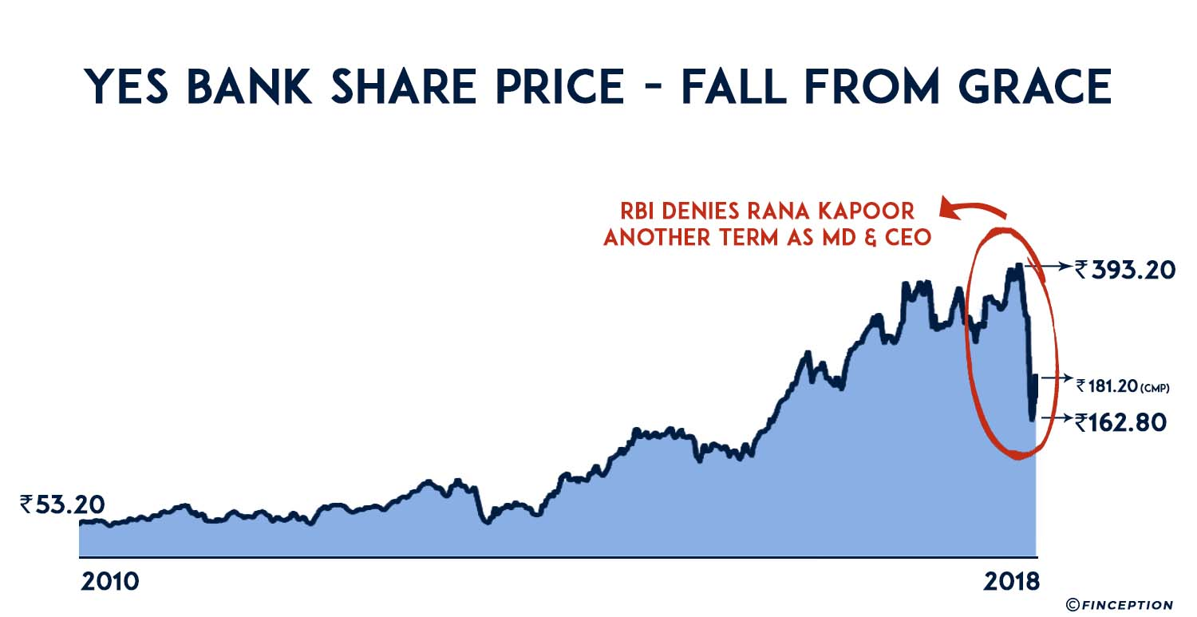

Introduction:
1. To determine the YES bank's stock’s future value on the national stock exchange. The advantage of a successful prediction of a stock's future price could results insignificant profit. The efficient-market hypothesis recommends that stock costs mirror all right now accessible data and any value changes that are not founded on recently uncovered data subsequently are an unpredictable.We have to build model which help us to predict the future stock prices.

Slide 4
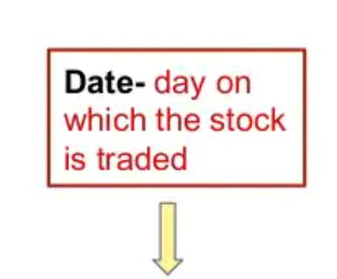
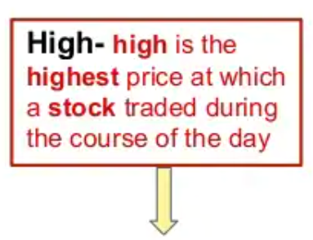
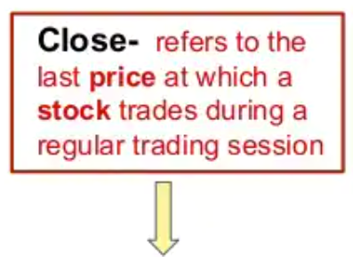
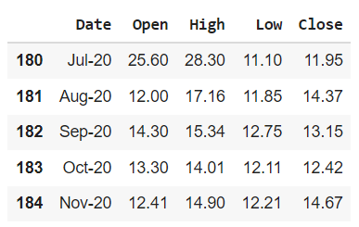
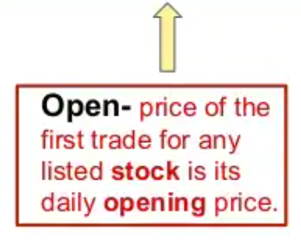
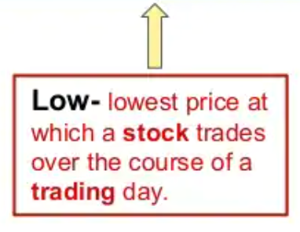
Data Summary:
We’ve YES BANK stock price dataset which has the monthly stock prices of the bank since it’s inception.
It includes over 185 records and 5 attributes.

Slide 5
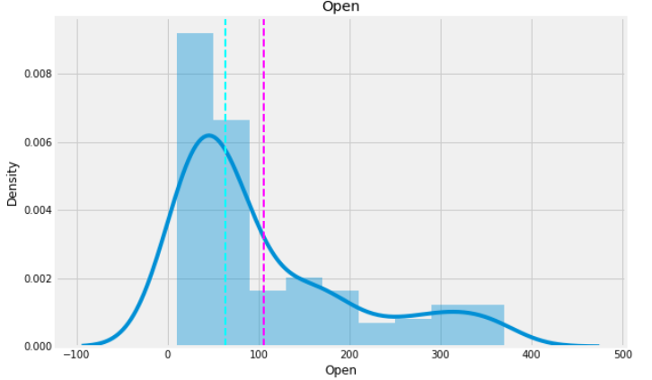
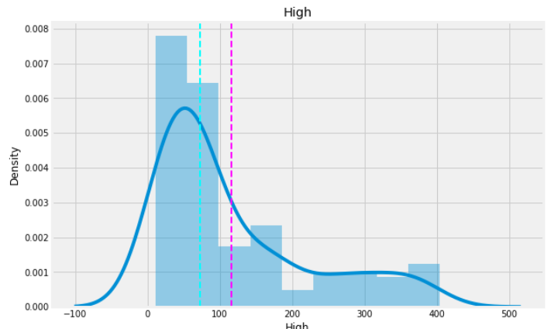
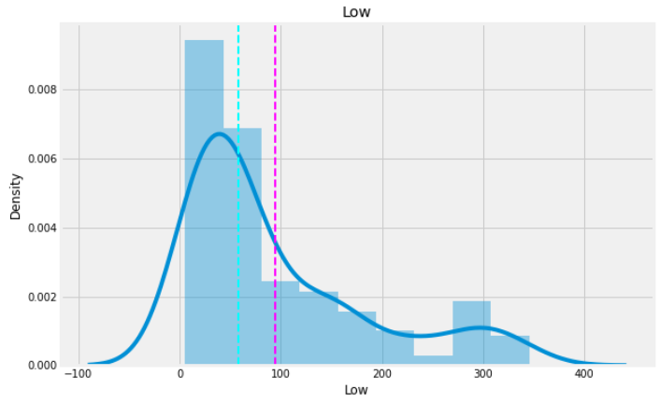
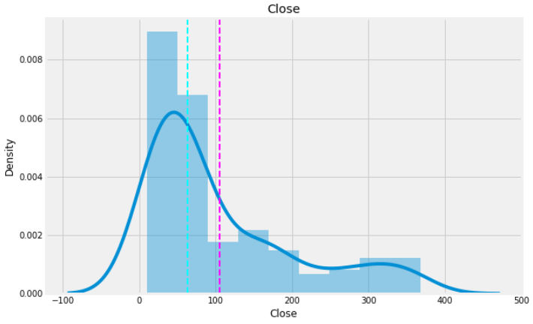
Univariate Analysis

Slide 6
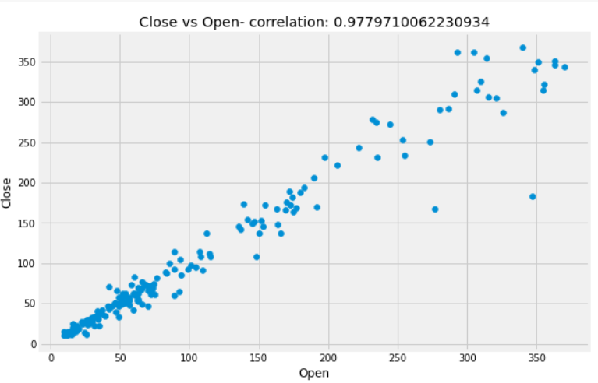
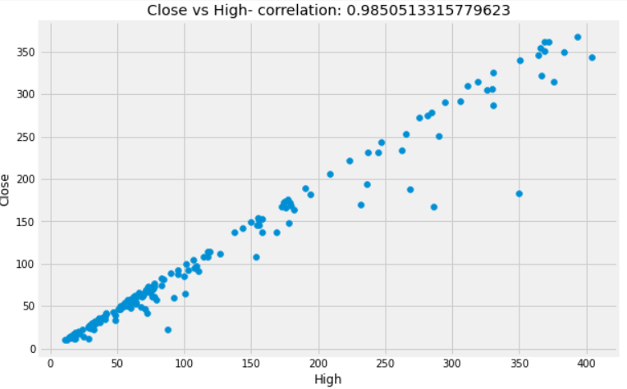
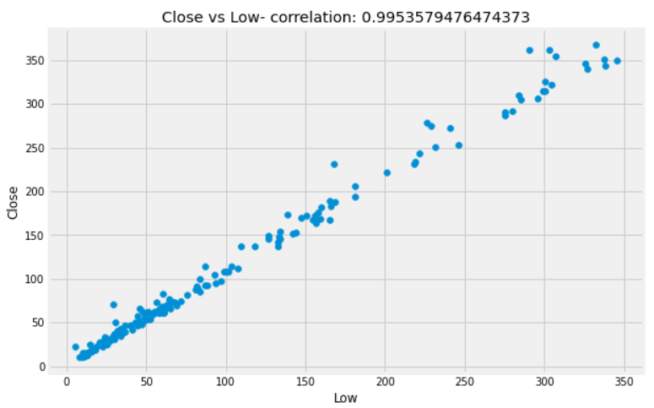
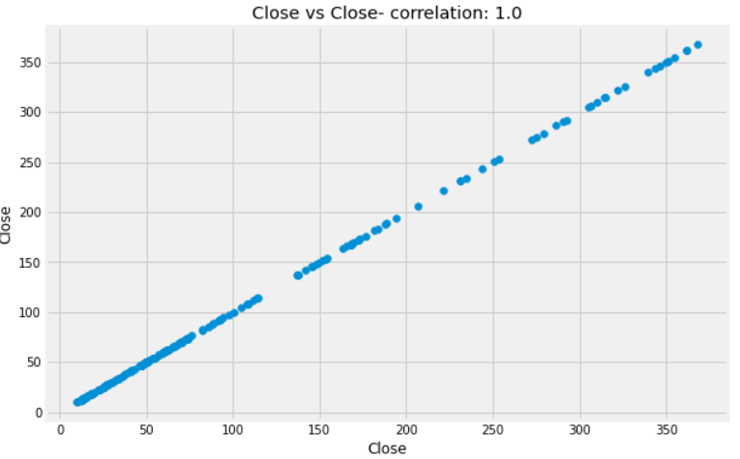
Bivariate Analysis

Slide 7
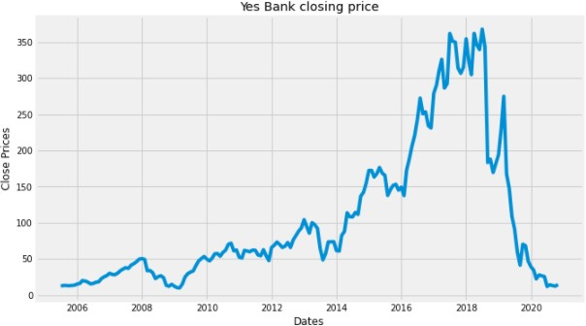
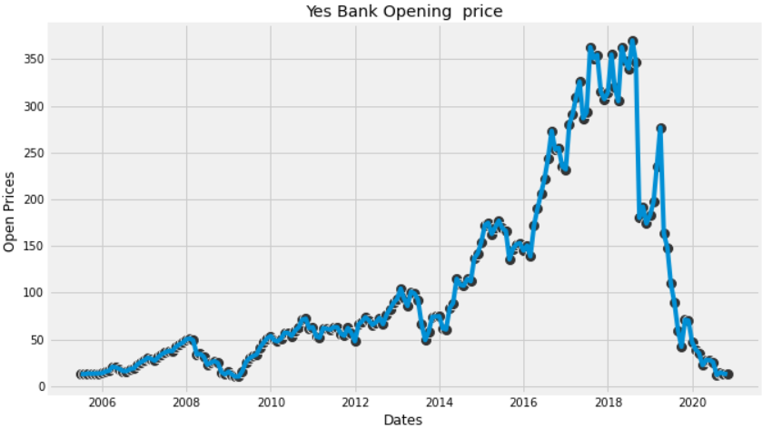
Analysis variables:

Slide 8
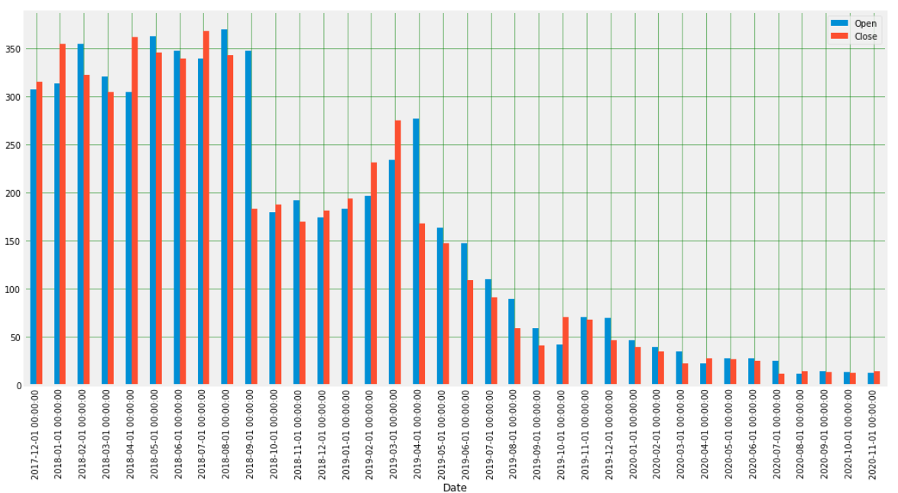
Analysis of Open vs Close Price

Slide 9
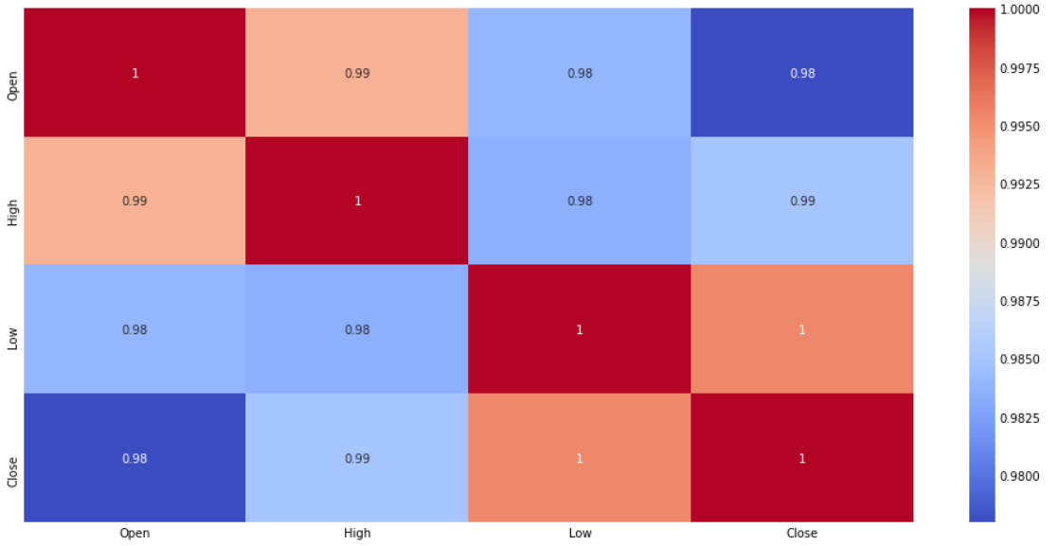
Correlation between the variables:

Slide 10
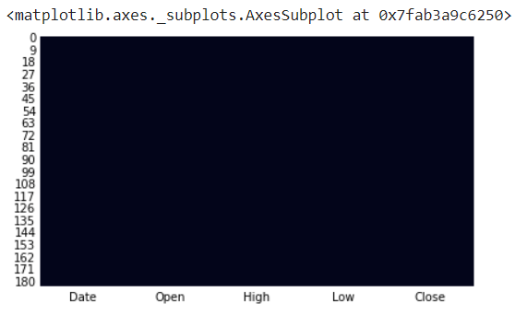
Where are the missing values in our data?
Data Preprocessing:

Slide 11
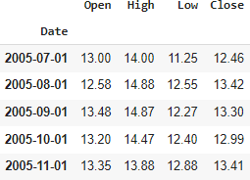
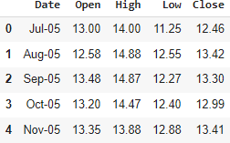
Data Cleaning
The Given Date in data is of format MMM-YY is converted to proper date of YYYY-MM-DD and given date column has dtype as object converting it into datetime format.
Converted

Slide 12
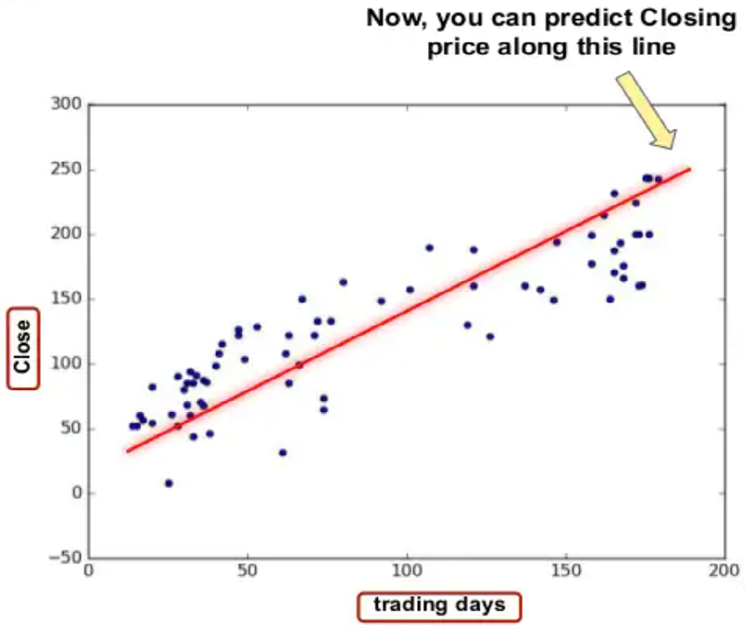
Linear Regression
Linear Regression:- Linear regression is one of the easiest and most popular Machine Learning algorithms. It is a statistical method that is used for predictive analysis.Linear regression algorithm shows a linear relationship between a dependent (y)(in our case is Close Price) and one or more independent (in our case Open,Low,high) variables, hence called as linear regression.

Slide 13
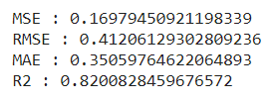
Lasso regression
lasso (least absolute shrinkage and selection operator; also Lasso or LASSO) is a regression analysis method that performs both variable selection and regularization in order to enhance the prediction accuracy and interpretability of the resulting statistical model.
Cross Validation :- Basically Cross Validation is a technique using which Model is evaluated on the dataset on which it is not trained i.e. it can be a test data or can be another set as per availability or feasibility.Here our best parameter is 'alpha': 0.01 and cv=3

Slide 14
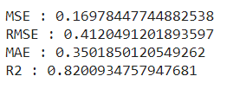

Ridge Regression
Ridge regression is a model tuning method that is used to analyse any data that suffers from multicollinearity. This method performs L2 regularization. When the issue of multicollinearity occurs, least-squares are unbiased, and variances are large, this results in predicted values to be far away from the actual values.
Cross Validation :- Here we found best parameter 'alpha': 20 and cv= 5.

Slide 15
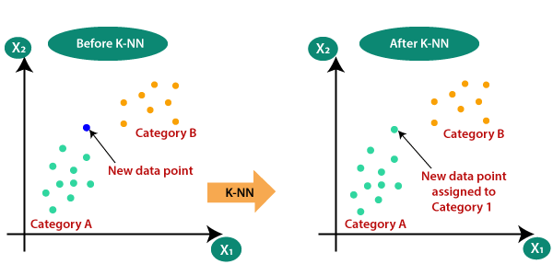
Knn (Nearest neighbours) Regressor:-
Knn (Nearest neighbours) Regressor:- KNN regression is a non-parametric method that, in an intuitive manner, approximates the association between independent variables and the continuous outcome by averaging the observations in the same neighbourhood.

Slide 16
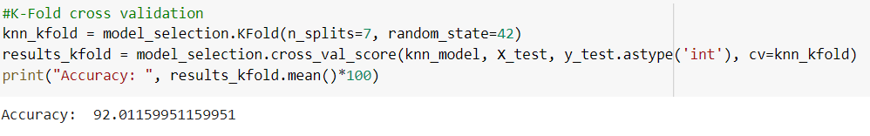
K-Fold Cross Validation
k-Fold Cross-Validation
Cross-validation is when the dataset is randomly split up into ‘k’ groups. One of the groups is used as the test set and the rest are used as the training set. The model is trained on the training set and scored on the test set. Then the process is repeated until each unique group as been used as the test set.In our case we take n_splits value = 7.
Our model gives accuracy about 92.01%.

Slide 17
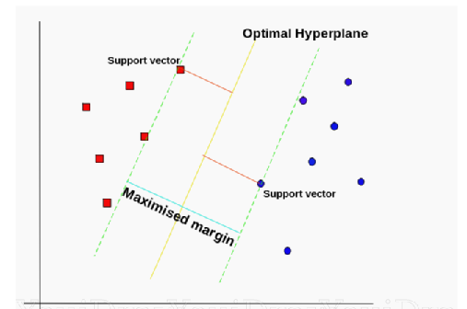
SVM Regressor
SVM:-Support Vector Regression is a supervised learning algorithm that is used to predict discrete values. Support Vector Regression uses the same principle as the SVMs. The basic idea behind SVR is to find the best fit line. In SVR, the best fit line is the hyperplane that has the maximum number of points.

Slide 18
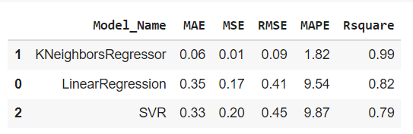
Evaluating all regressor models
KNeighborsRegressor gives lowest MAE, MSE, RMSE, MAPE and best R^2 value.
Overall we can say that KNeighborsRegressor is the best model among all regression model which gives around 92.00% accuracy of predicting stock price of our dataset.

Slide 19
Time-Series Forecasting
Time series is a sequence of observations recorded at regular time intervals.
Depending on the frequency of observations, a time series may typically be hourly, daily, weekly, monthly, quarterly and annual. Time series analysis involves understanding various aspects about the inherent nature of the series so that you are better informed to create meaningful and accurate forecasts.
For time series forecasting we select only closing price feature of stock.
Then we’ve checked series is stationary or not because time series analysis only works with stationary data.
We'll use the Augumented Dickey Fuller (ADF) test to check if the price series is stationary.The null hypothesis of the ADF test is that the time series is non-stationary. So, if the p-value of the test is less than the significance level (0.05) then we can reject the null hypothesis and infer that the time series is indeed stationary.

Slide 20
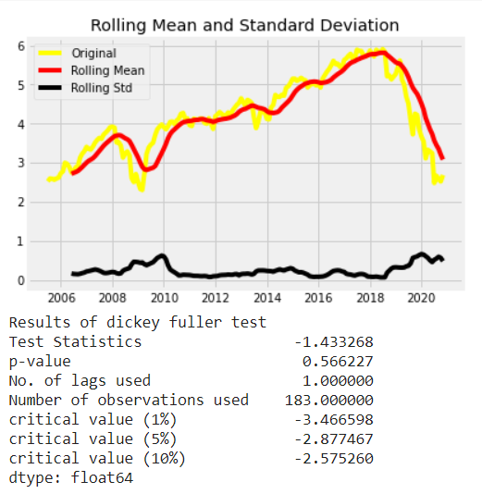
Contd..
So, in our case, if the p-value > 0.05 we'll need to find the order of differencing.

Slide 21
Contd..
We see that the p-value is greater than 0.05 so we cannot reject the Null hypothesis. Also, the test statistics is greater than the critical values. so the data is non-stationary.
In order to perform a time series analysis, we may need to separate seasonality and trend from our series. The resultant series will become stationary through this process.
So let us separate Trend and Seasonality from the time series.
How to remove Stationarity?
Subtract the previous value from the current value. Now if we just difference once, we might not get a stationary series so we might need to do that multiple times.
And the minimum number of differencing operations needed to make the series stationary needs to be imputed into our ARIMA model.

Slide 22
ARIMA
So what exactly is an ARIMA model?
ARIMA, short for ‘Auto Regressive Integrated Moving Average’ is actually a class of models that ‘explains’ a given time series based on its own past values, that is, its own lags and the lagged forecast errors, so that equation can be used to forecast future values.
An ARIMA model is characterized by 3 terms (p, d, q):
p is the order of the AR term
d is the number of differencing required to make the time series stationary
q is the order of the MA term
As we see in the parameters required by the model, any staionary time series can be modeled with ARIMA models

Slide 23
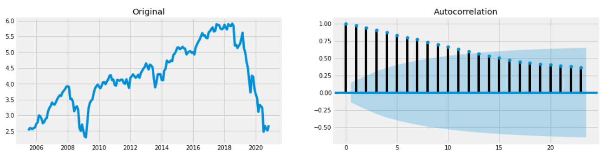
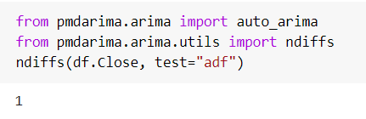
Selecting p,d,q values 1)Determing value of d

Slide 24
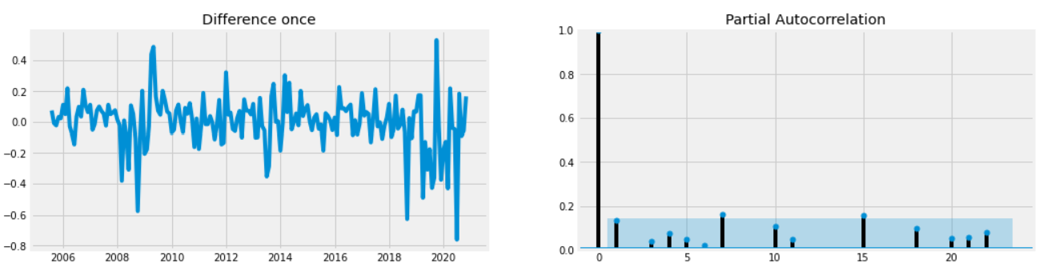
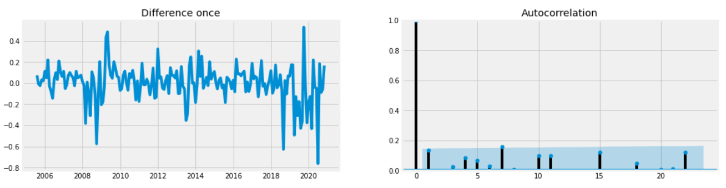
2) Determing the value of p
3) Determing the value of q

Slide 25
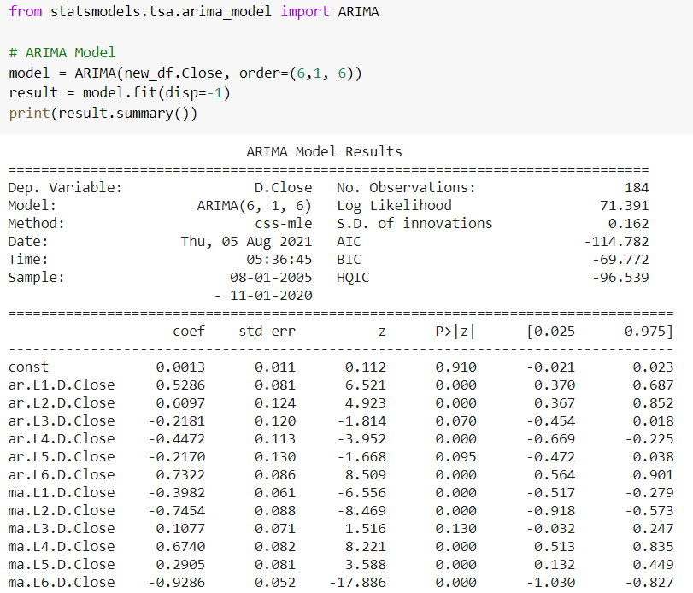
ARIMA model

Slide 26
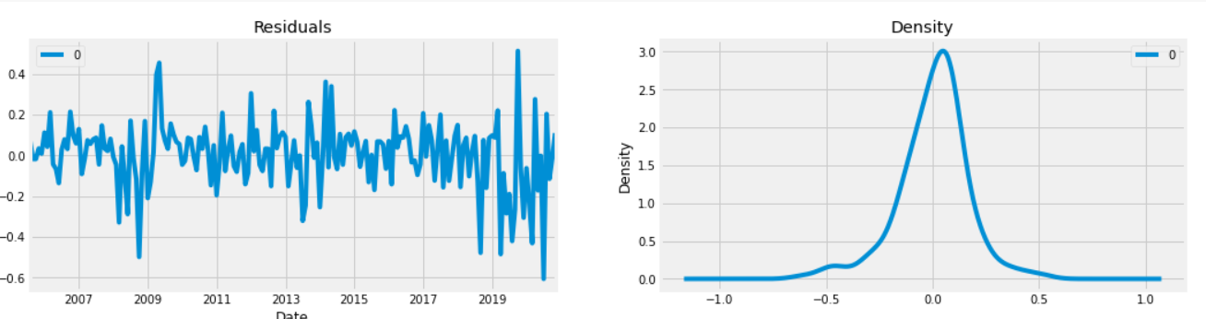
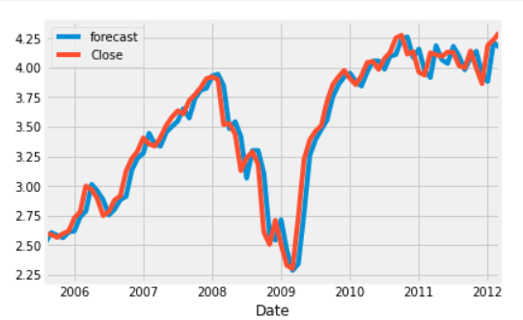
Plot residuals error
Actual vs Forecasted

Slide 27
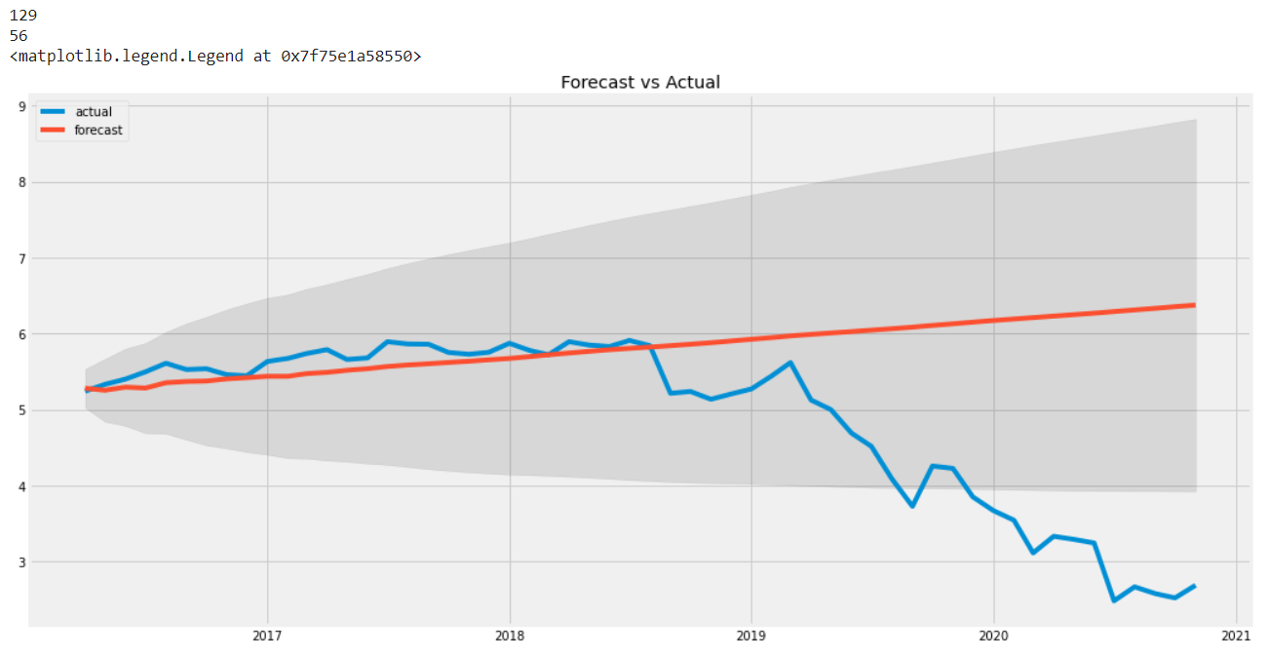
ARIMA Model Forecast
Here we split the data into train-test and considering the next 56 months we get this below forecast graph

Slide 28
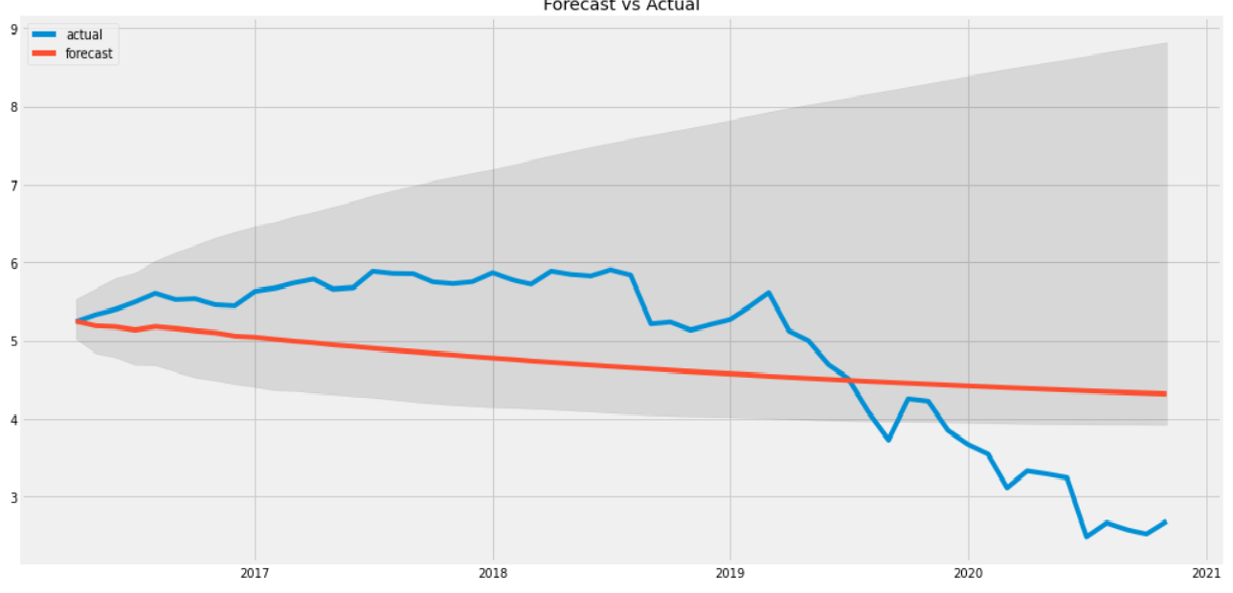
Contd..
From the chart, the ARIMA(6,1,6) model seems to give a directionally correct forecast.That seems fine. But each of the predicted forecasts is consistently below the actuals. That means, by adding a small constant to our forecast, the accuracy will certainly improve. So, there is definitely scope for improvement. So, what I am going to do is to increase the order of differencing to zero, that is set d=0 and iteratively increase p to up to 6 and then q up to 5.

Slide 29
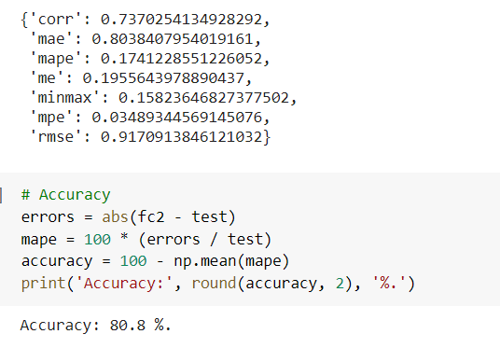
Evaluating ARIMA Model
Here we can see that around 17.41% MAPE(Mean Absolute Percentage Error) implies the model is about 81 % accurate in predicting the test set observations.

Slide 30
Building Fbprophet Model:
Facebook Prophet is an open-source forecasting method implemented in Python.It provides automated forecasts. Prophet is used in many applications relating to time series data and to gather sample time forecast data. In the case of such models, getting exact future data is never possible, but we can somehow get the future trend.
The input to Prophet is always a dataframe with two columns: ds and y
The ds (datestamp) column should be of a format expected by Pandas, ideally YYYY-MM-DD for a date or YYYY-MM-DD HH:MM:SS for a timestamp. The y column must be numeric, and represents the measurement we wish to forecast.
Components of our model:
{'additive': ['monthly', 'yearly', 'additive_terms', 'extra_regressors_additive', 'holidays'],
'multiplicative': ['multiplicative_terms', 'extra_regressors_multiplicative']}

Slide 31
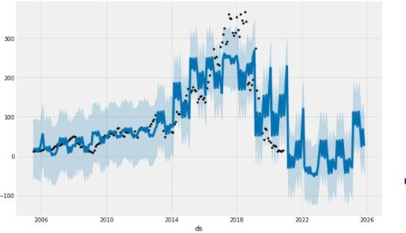
Forecasting model predictions

Slide 32
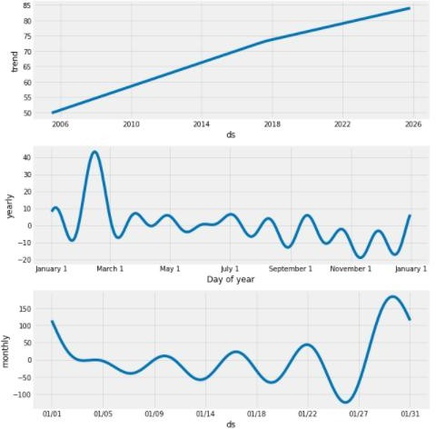
Plotting components of our model to see the trend, yearly seasonality,and weekly seasonality of the time series.

Slide 33
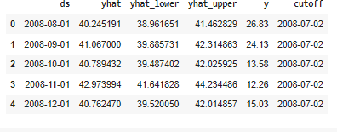
Cross Validation for time series:
Prophet includes functionality for time series cross validation to measure forecast error using historical data. This is done by selecting cutoff points in the history, and for each of them fitting the model using data only up to that cutoff point. We can then compare the forecasted values to the actual values.
Parameters used:(model, horizon="365 days", period='180 days', initial='1095 days')

Slide 34
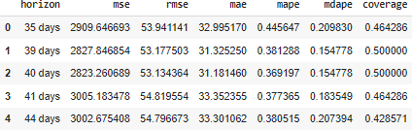
Evaluation Metrics:
Here, we use the performance_metrics utility to compute the Mean Squared Error(MSE), Root Mean Squared Error(RMSE),Mean Absolute Error(MAE), Mean Absolute Percentage Error(MAPE) and the coverage of the the yhat_lower and yhat_upper estimates.

Slide 35
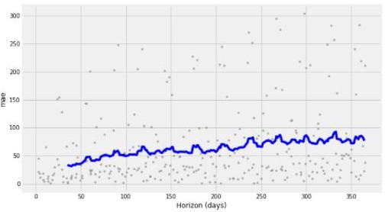
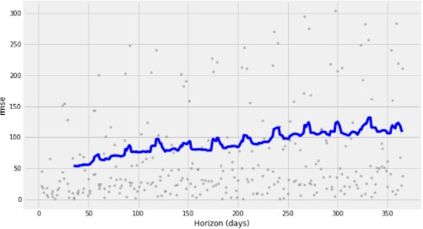
Plotting MAE, RMSE and MAPE
Mean Absolute Error
Root Mean Square Error

Slide 36
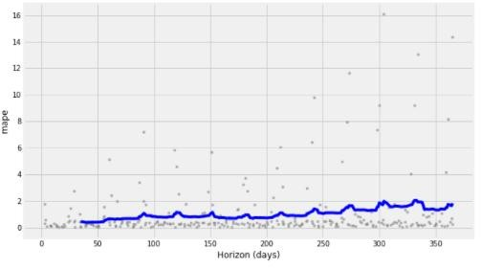
Contd..
Mean Absolute Percentage Error
Dots show the absolute percent error for each prediction in data-frame.
The blue line shows the MAPE, where the mean is taken over a rolling window of the dots.

Slide 37
Challenges
Small dataset so it’s difficult to get good model accuracy.
Making the data stationary for time series model.
Selecting the values of p,d,q for ARIMA.
Adding monthly trend to fbprophet.

Slide 38
Conclusion
In EDA part we observed that
1) There is increase in trend of Yes Bank's stock's Close price till 2018 an then sudden decrease.
2)There is increase in trend of Yes Bank's stock's Open price till 2018 an then sudden decrease.
3)We observed that open vs close price graph concluded that after 2018 yes bank's stock hitted drastically.
We implemented three regressor
1)KNN regressor with highest accuracy - 92.00%
2)linear regression accuracy - 82.00%
3)SVM regressor acccuracy - 79.00%
We implemnted the ARIMA model and we got accuracy about 81.00%.
We used timeseries approach for the FBprophet forcast the error of 2.5% are typical for predictions one month into the future, and that errors increase up to around 18-19% for predictions that are a year out.
Fbprophet is the best performing time series model in terms of accuracy.

Slide 39
Thank You!

